Slide 1

Refactoring to a S.O.L.I.D. Foundation
DX/TED
Steve Bohlen
Principal Software Engineer
& Technical Evangelist
sbohlen@gmail.com http://blog.unhandled-exceptions.com @sbohlen

Slide 2
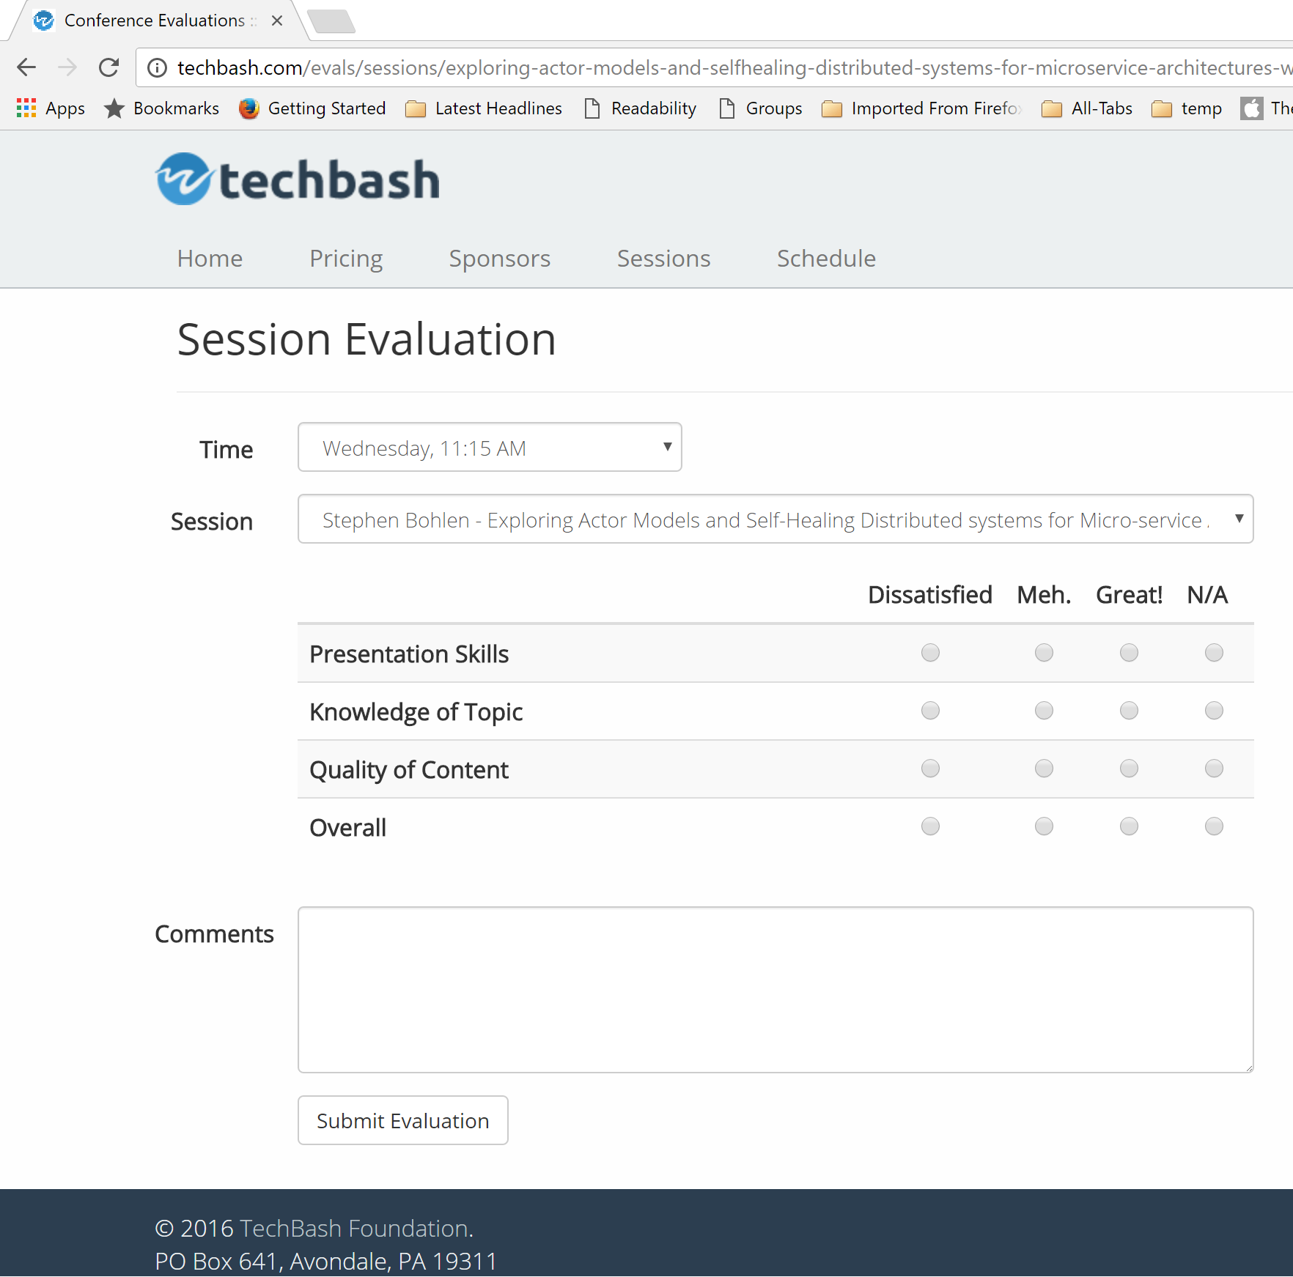




Please Complete the Evals!
http://techbash.com/schedule

Slide 3



Steve Bohlen
Over 25 years as a software developer
LISP, Delphi, C/C++, VB, VB.NET, Java, Ruby, C#, JavaScript
Principal Software Engineer, Microsoft
Co-Founder, NYC Alt.Net User Group
http://nyalt.net
Co-Organizer, NYC DDD User Group
http://dddnyc.org
Contributor: various OSS projects
NHibernate http://www.nhforge.org
Common.Logging http://net-commons.github.io/common-logging
NDbUnit http://www.googlecode.com/ndbunit
Spring.NET http://www.springframework.net
blog: http://blog.unhandled-exceptions.com
e-mail: sbohlen@gmail.com
twitter: @sbohlen
Membership: ASP Insiders, C# Insiders, Telerik Insiders, INETA Board of Directors
Alumni

Slide 4

I am a
employee…
…but these thoughts are my own!

Slide 5


Slide 6
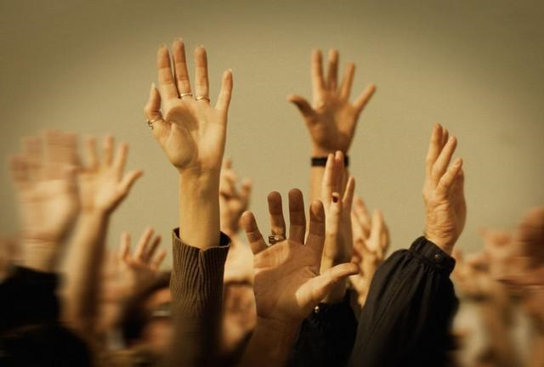

Slide 7
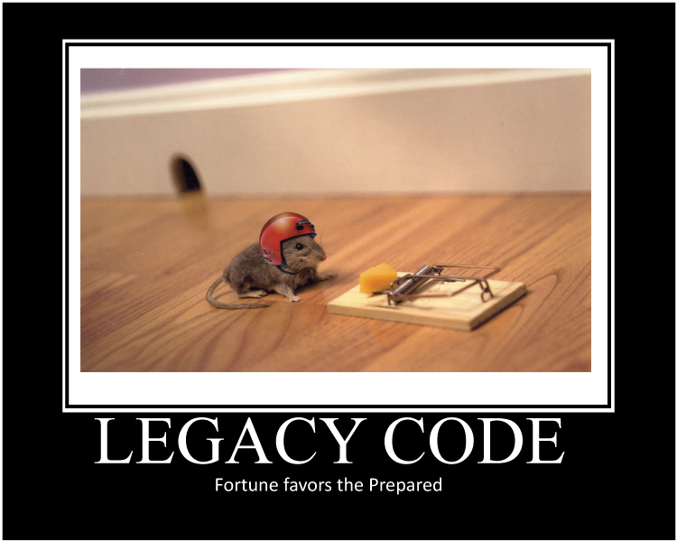

Slide 8
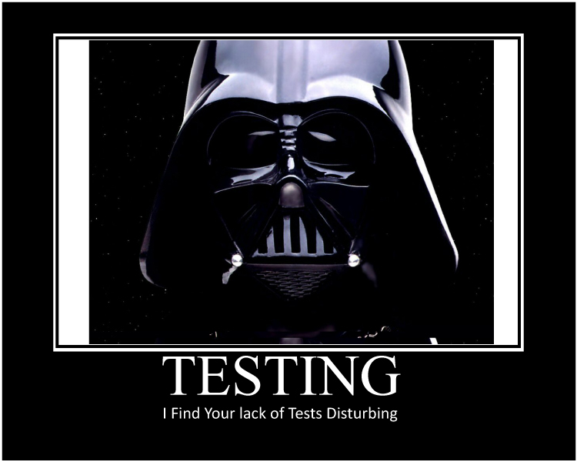

Slide 9
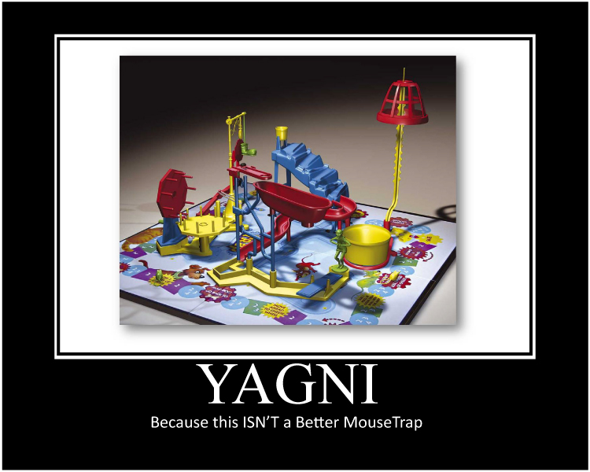

Slide 10


Slide 11
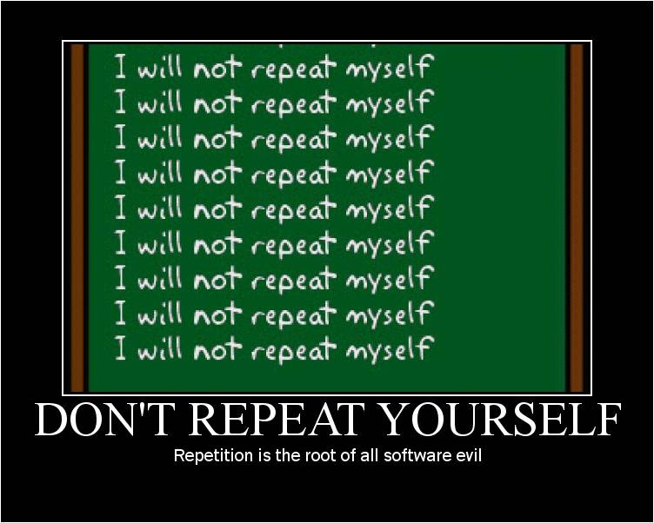

Slide 12
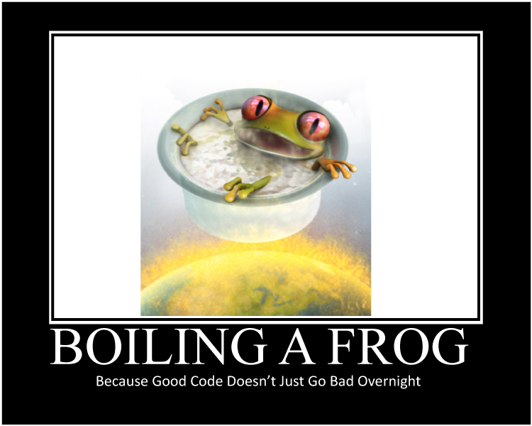

Slide 13
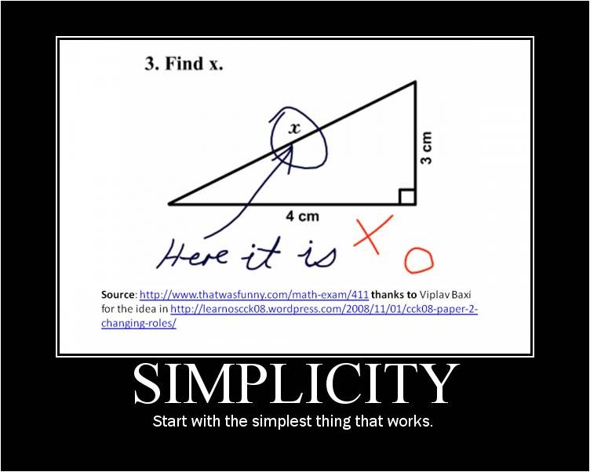

Slide 14


Slide 15
Refactoring Tools
Developer Express CodeRush
http://devexpress.com/coderush
JetBrains Resharper
http://www.jetbrains.com/resharper/
Telerik JustCode
http://www.telerik.com/products/justcode.aspx
Visual Studio Professional
Notepad!

Slide 16
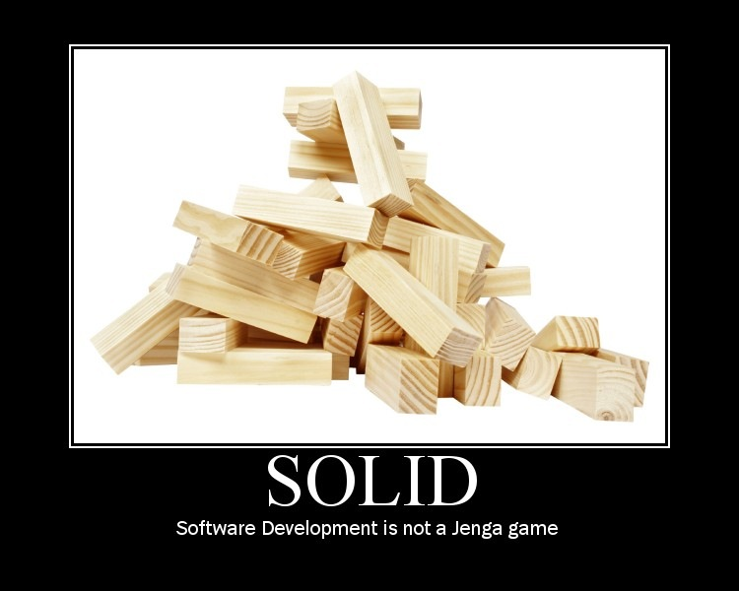

Slide 17
Introduction to S.O.L.I.D.
S
O
L
I
D
RP
ingle Responsibility Principle
CP
pen-Close Principle
SP
iskov Substitution Principle
SP
nterface Segregation Principle
IP
ependency Inversion Principle

Slide 18
Introduction to S.O.L.I.D.
S
O
L
I
D
ingle Responsibility Principle
pen-Close Principle
iskov Substitution Principle
nterface Segregation Principle
ependency Inversion Principle

Slide 19
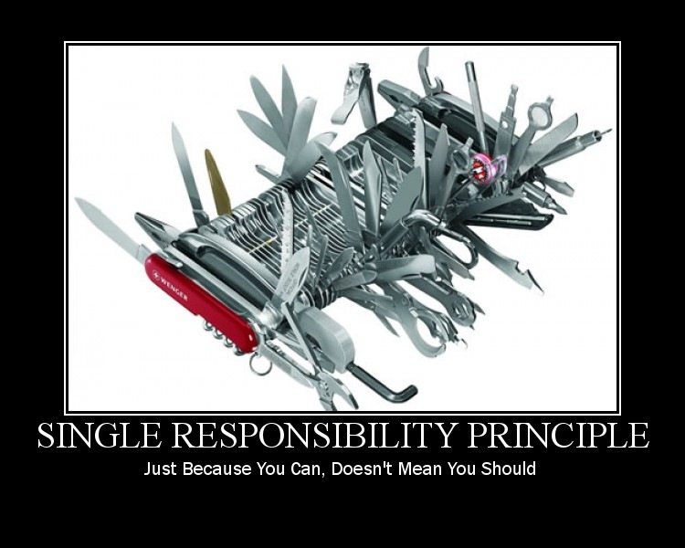

Slide 20
Single Responsibility Principle
There should never be more than one reason for a class to change.

Slide 21
Refactoring to a S.O.L.I.D. Foundation
SRP Demo

Slide 22
Introduction to S.O.L.I.D.
S
O
L
I
D
ingle Responsibility Principle
pen-Close Principle
iskov Substitution Principle
nterface Segregation Principle
ependency Inversion Principle

Slide 23
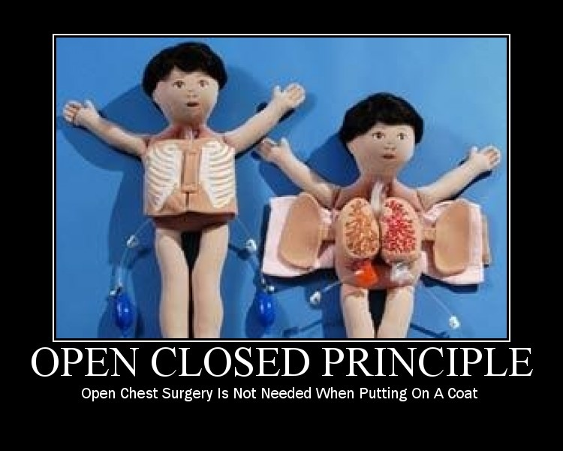

Slide 24
Open-Closed Principle
Software Entities (Classes, Modules, Functions, etc.)should be Open for Extension, but Closed for Modification.

Slide 25
Refactoring to a S.O.L.I.D. Foundation
OCP Demo

Slide 26
Introduction to S.O.L.I.D.
S
O
L
I
D
ingle Responsibility Principle
pen-Close Principle
iskov Substitution Principle
nterface Segregation Principle
ependency Inversion Principle

Slide 27
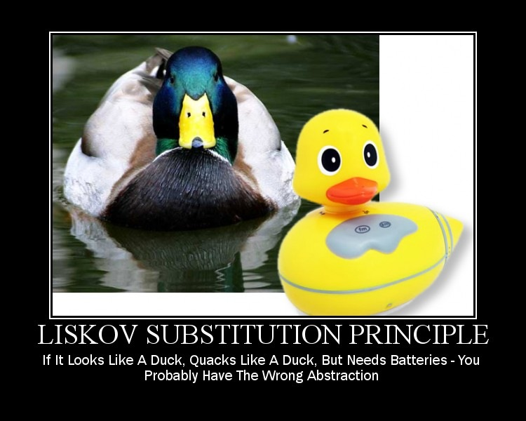

Slide 28
Liskov Substitution Principle
If for each object o₁ of type S
there is an object o₂ of type T such that
for all programs P defined in terms of T,
the behavior of P is unchanged when o₁ is substituted for o_{2,} then S is a subtype of T.
WTF ?!?

Slide 29
Liskov Substitution Principle
Functions that use pointers or references to base classes must be able to use objects of derived classes without knowing it.

Slide 30
Refactoring to a S.O.L.I.D. Foundation
LSP Demo

Slide 31
Introduction to S.O.L.I.D.
S
O
L
I
D
ingle Responsibility Principle
pen-Close Principle
iskov Substitution Principle
nterface Segregation Principle
ependency Inversion Principle

Slide 32
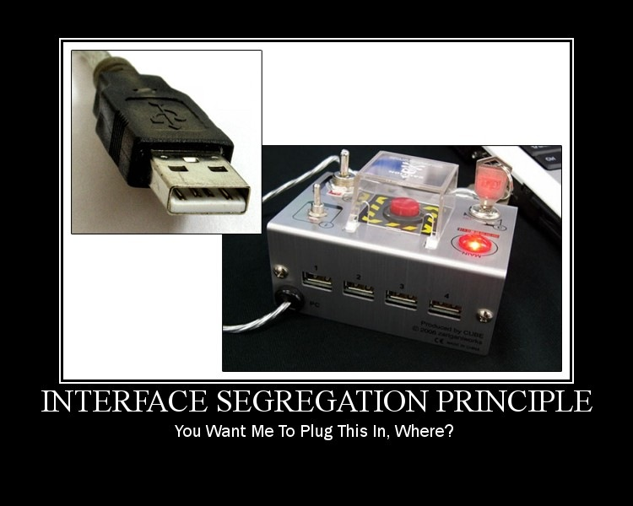

Slide 33
Interface Segregation Principle
Clients should not be forced to depend upon interfaces that they do not use.

Slide 34
Refactoring to a S.O.L.I.D. Foundation
ISP Demo

Slide 35
Introduction to S.O.L.I.D.
S
O
L
I
D
ingle Responsibility Principle
pen-Close Principle
iskov Substitution Principle
nterface Segregation Principle
ependency Inversion Principle

Slide 36
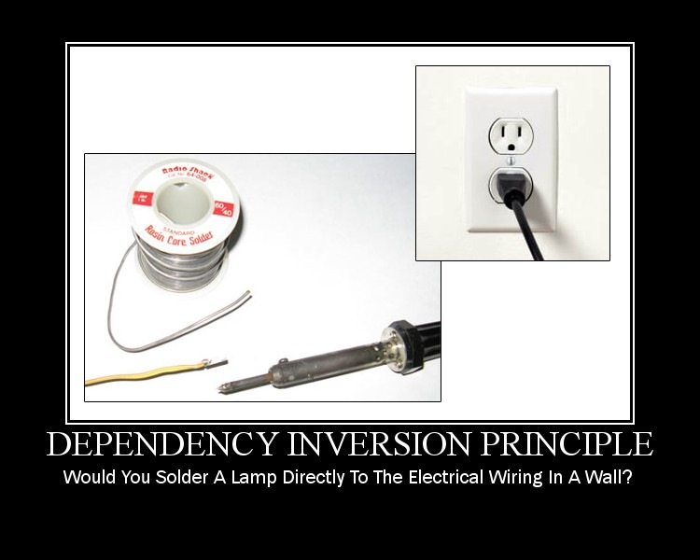

Slide 37
Dependency Inversion Principle
High Level Modules should not depend
upon Low Level Modules. Both should
depend upon abstractions.
Abstractions should not depend upon details. Details should depend upon abstractions.

Slide 38
Refactoring to a S.O.L.I.D. Foundation
DIP Demo

Slide 39
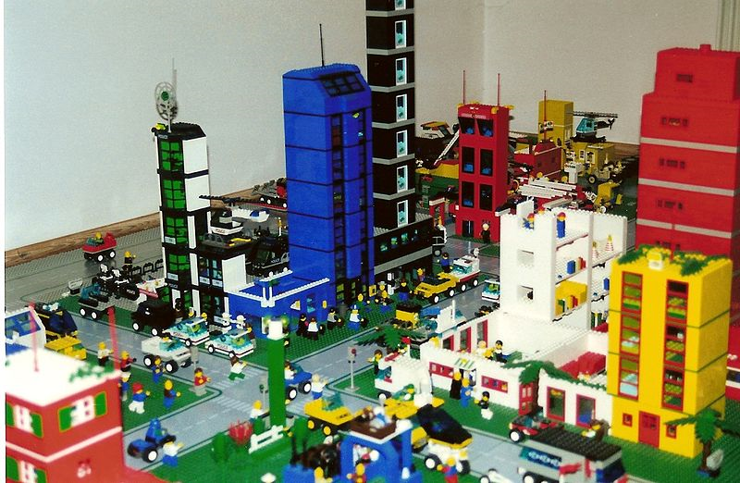
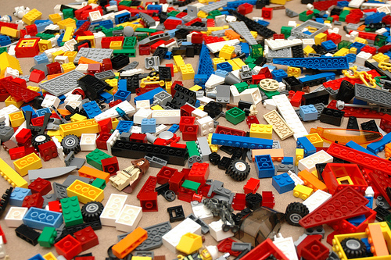
Thinking About Re-Assembly
Presto!

Slide 40
Dependency Injection Frameworks
StructureMap
Spring.NET
Castle Windsor
NInject
Funq
Unity
More…

Slide 41
Refactoring to a S.O.L.I.D. Foundation
Closing Thoughts

Slide 42
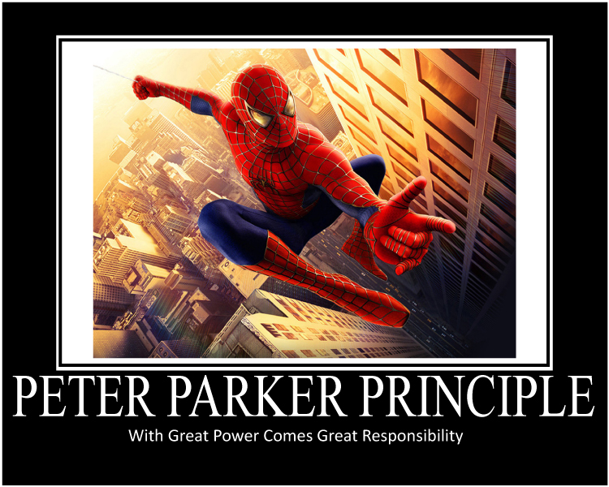

Slide 43


Slide 44
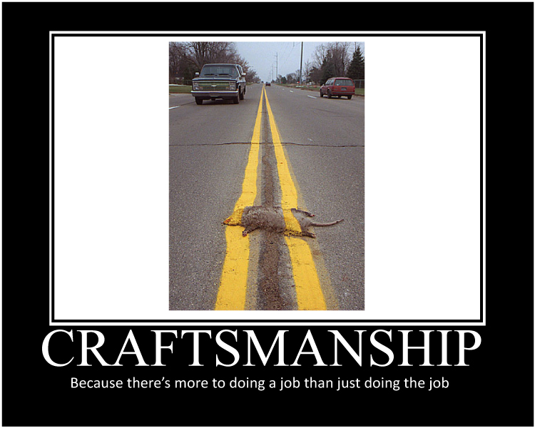

Slide 45
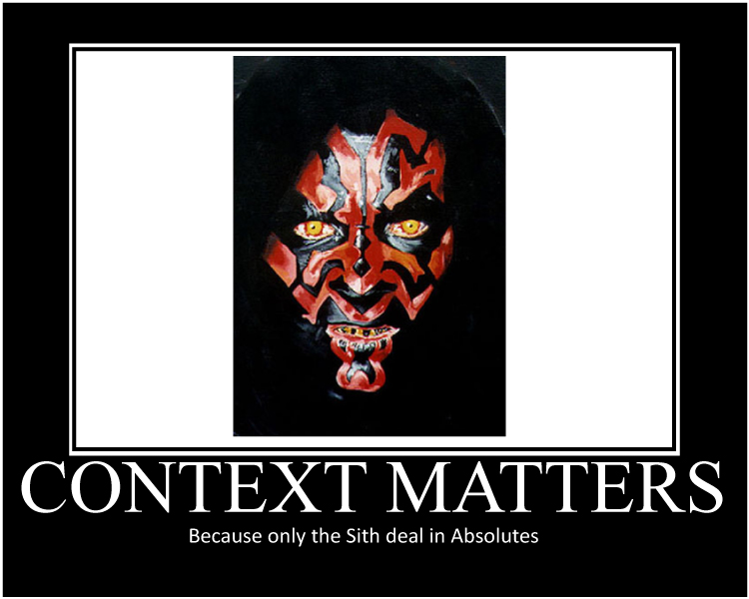

Slide 46
~fini~
DX/TED
Steve Bohlen
Principal Software Engineer
& Technical Evangelist
sbohlen@gmail.com http://blog.unhandled-exceptions.com @sbohlen

